Slide 1
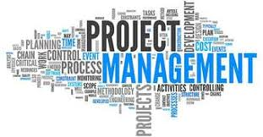
Project Management Fundamentals

Slide 2
Course Overview
Goal
Starter class that helps you wrap your head around project management basic concepts and what to expect when you are part of a project team.
Intended Audience
Anyone who finds themselves on a project.
Learning Objectives
Become familiar with fundamental project management concepts and terms
Understand project phases and different delivery approaches
Be exposed to typical project roles and responsibilities
Learn project team members part in:
schedule building and maintenance
Issue identification and resolution
risk identification, mitigation planning and monitoring
To be able to define the value of a Project Management Office

Slide 3
Introductions
Instructor background
Class Introductions
Name
Role
What you are hoping to get out of this training.

Slide 4
Foundation Concepts
Projects versus Operations
Project Management Defined
Value of Project Management
Programs and Portfolios
Triple constraint

Slide 5
What is a project?
Project Management Institute definition
A project is a temporary endeavor, with a definite beginning and end, undertaken to create a unique product, service, or result.
Temporary – has a start and an end
Unique – product, service or result, is different in some distinguishing way from other products, services or results
Characteristics
Projects | Routine/Operational Work
Defined beginning and end | Is repetitive
End results have specific goals | Uses already established processes
Follows an organized approach to meeting deadlines | Maintaining a system or service
Result is handed off to operations
These definitions are guidelines and if the work effort meets the project characteristics you can most likely use project management.

Slide 6
Activity: Pick the Project
Example | Project (Y or N)
Responding to a customers request for information
Catering a corporate event
Meeting with an employee to discuss a new procedure
Producing the corporate annual report
Hiring a sales team for a new office
Writing and publishing a book
Writing a progress update

Slide 7
Results: Pick the Project
Example | Project (Y or N)
Responding to a customers request for information | N
Catering a corporate event | Y
Meeting with an employee to discuss a new procedure | N
Producing the corporate annual report | N
Hiring a sales team for a new office | Y
Writing and publishing a book | Y
Writing a progress update | N

Slide 8
What is project management?
A Few Definitions:
The discipline of planning, organizing, securing and managing resources to bring about the successful completion of specific project goals and objectives.
The application of knowledge, skills, tools and techniques to accomplish projects effectively and efficiently.
A combination skills, tools and techniques used to keep budget and schedule under control.

Slide 9
Why use project management?
To increase the delivery of projects on time, on budget and to our customers specifications.
Project management offers a way to avoid frustration of missed deadlines, unclear expectations and budget overruns by:
Clearing defining responsibilities for activities
Focusing resources on specific objectives
Providing a structure for communicating within and across organizational boundaries

Slide 10
Programs and Portfolios
PORTFOLIO
A program is a collection of related projects.
A project portfolio is a collection of projects and programs that are managed as a group to achieve strategic objectives.
A project can exist without any program.
Project
PROGRAM
Project
Project
Project

Slide 11
Common PM Terms
Constraints
A limiting factor that affects the execution of a project or process.
Critical Path
The sequence of project activities which add up to the longest overall duration. This determines the shortest time to complete the project.
Decomposition
The process of subdividing project deliverables and project work into smaller, more manageable components.
Deliverable
Any unique and verifiable product, result, or capability to perform a service that is required to produce a process, phase, or project.
Duration
The total number of work periods required to complete a schedule activity or work breakdown structure component.

Slide 12
Common PM Terms
Effort
The number of labor units required to complete a schedule activity often expressed in hours, days, weeks.
Dependency
Functional Manager
Person with management authority over an organizational unit within a functional organization.
Gantt Chart
A type of bar chart that illustrates a project schedule. Lists tasks to be performed on vertical axis, and time intervals on the horizontal.
Milestone
A significant point or event in a project.
Relationships between tasks. This could internal or external to a project.

Slide 13
Common PM Terms
Stakeholder
Is either an individual, group or organization who is impacted by the outcome of a project. They have an interest in the success of the project.
Baseline
Value or condition which future measurements will be compared. It is a point of reference. There are normally 3 baselines: schedule, cost and scope.
Risk
The probability of occurrence of a specific event that affects the pursuit of objectives.
Scope
Constitutes everything it is supposed to accomplish in order to be deemed successful.

Slide 14
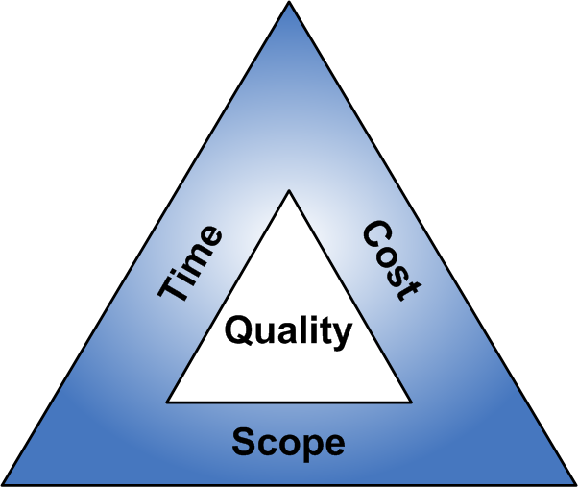
Managing Projects
Using the Triple Constraint
What is the Triple Constraint?
Time = Schedule
Scope = Requirements
Cost = Labor, material, equipment
The Trick
To balance the three sides to complete the project
To combine art and science
Know it is an on-going effort to define and refine project

Slide 15
Key Messages
A project is a temporary endeavor undertaken to create a unique product or service
Project management is a combination skills, tools and techniques used to keep budget and schedule under control.
There is a difference between project and routine work

Slide 16
Phases of a Project
Project Lifecycles
Phase Goals and Activities
Project Management Approaches

Slide 17
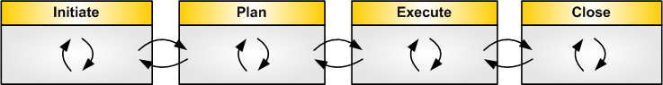
Project Lifecycles
Projects are usually divided into phases
Collectively, these phases make up the project life cycle
Typical phases are: Initiating, Planning, Executing and Closing
Might be called by different names but goals of phases are the same
Project Type Determines
What activities and deliverables are managed in each phase
Project Size Determines
Amount of documentation
Formality and frequency of communications

Slide 18
Phase Goals and Activities
Phase | Goal | Activity Overview
Initiate | To define project objectives, scope and obtain project authority to allocate resources to the project | Beginning of the project where the idea for the project is explored and elaborated
Plan | Commit to deliver agreed upon functionality within specific time & budget | Break down the larger project into smaller parts Build your team Define body of work and associated task timings
Execute | Build, test and accept agreed upon solution is ready for deployment | Turn plans into action
Close | Accept deployed solution, close out project | Provide final deliverables Release project resources Determine the success of the project
Monitor and Control | To track, review, report progress, and apply corrective actions to keep project on track to meet its goals | Monitor team progress against plans Assist team by removing roadblocks that could impact project delivery

Slide 19
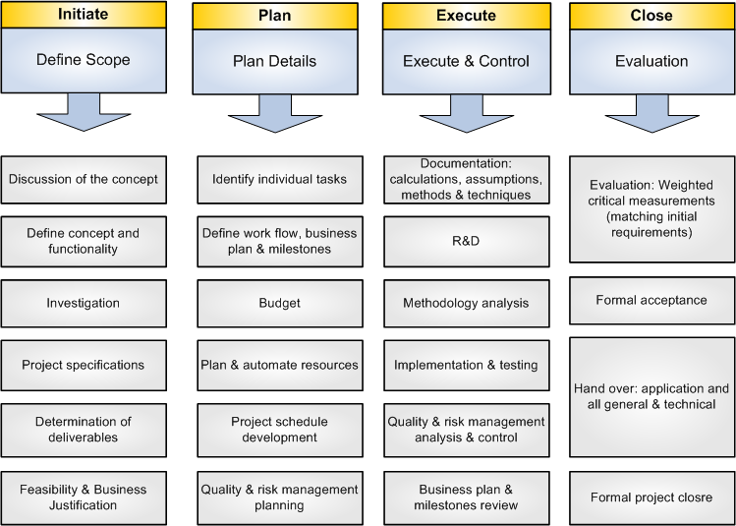
Sample Project Lifecycle

Slide 20


Project Delivery Framework – Level 1 Information Services
Kick Off
Readiness
Execution
Check
Launch
Readiness
Project
Closure
1
2
3
4
Initiate
Plan
Execute
Close
Monitor and Control
Meeting Agenda/Minutes
Issue and Action Log
Project Schedule
Decision Log
Change Register
Status Reporting
Risk Register
Budget Tracker
Project Proposal Package
Secure Funding
Project Charter
Stakeholders Matrix
Project Site
Project Management Plan
Communications Package
Resource Plan
Project Kick Off
Monitor and Control
Lessons Learned Report
Project Closure Checklist
Project Management
Requirements
Requirements Traceability Matrix
Use Cases or User Stories
Process Flows
Gap Analysis
Test and Training Plan
Support Plan
User Test Scripts
Training Materials
Production Validation Plan
User Testing
User Training
Solution Delivery
Design Materials
Design Reviews
Data Migration Plan
Decommission Plan
Build/Configure Solution
Prototypes
Production Validation
Transition to Operations
Obtain project approval, define project objectives, and scope
Commit to deliver agreed upon functionality within specific time & budget
Build, test and accept agreed upon solution is ready for deployment
Accept deployed solution,
close out project

Slide 21
Project Management Approaches
Different approaches, same concepts
Iterative
Initiate
Plan
Execute
Close
Start
Finish
Monitor and Control
Agile
Initiate
Plan
Initiate
Plan
Initiate
Plan
Execute
Close
Execute
Close
Execute
Close
Start
Iteration
Iteration
Finish
Monitor and Control

Slide 22
Key Messages
A project lifecycle consists of at least 4 processes: initiating, planning, executing and closing
Project lifecycle vary based on type and size of project
Select appropriate tool for the project type, size and team

Slide 23
People and Projects
Project Roles and Responsibilities

Slide 24
Key Roles Defined
Role | Description
Project Sponsor | The authorization and funding source of the project. The person who defines the project goals and to whom the final results are presented.
Stakeholder | Persons who are actively involved in the project, or whose interests may be positively or negatively affected by the execution or completion of the project.
Steering Committee | Formed when a project has stakeholders from different areas of a organization. Represent stakeholder interests Align project scope with the requirements of stakeholder groups Decision making authority for the project
Project Manager | Person assigned to achieve a project’s objectives. Responsible for seeing a project through to its successful completion Manages day to day project activities Keeps the line of communication open to all interested parties

Slide 25

Typical Project Manager Role
Main function: Facilitates all aspects of a project and supports the project
team in delivering solutions on time and on budget.
Monitors and communicates project progress
Leads effort to identify and monitor risks
Project Team
Forecasts and tracks budget
Project Manager
Tracks and drives issues to resolution
Identifies and engages stakeholders
Assists team in removing roadblocks
Assembles and manages project team
Leads effort to plan and organize work

Slide 26
Key Roles Defined
Role | Description
Project Team Members | Execute tasks and produce deliverables as outlined in the project schedule: Work the schedule Accountable to the Project Manager Share subject matter expertise Communicate status and issues
Functional Manager | Manages resources in a specific department and generally directs the work of individuals from that functional area. On projects the functional manager shares responsibility for directing the work of individuals with the project manager. It is the responsibility of the project manager to avoid any conflicts with the functional manager and coordinate the respective needs regarding the use of resources to complete the project work. The activities of a functional manager may include: Assign specific individuals to the project team Participate in the initial planning Provide subject matter expertise Recommend changes to the project, including corrective actions Manage activities within their functional areas Assist with problems related to team member performance Improve staff utilization

Slide 27
Key Roles Defined
Role | Description
Business Analyst | Analyzes an organization or business domain (real or hypothetical) and documents its business or processes or systems, assessing the business model or its integration with technology. Interacts with the stakeholders and subject mater experts in order to understand their problems and needs Gathers, documents, and analyzes business needs and requirements Interacts with technical team to validate that solution meets requirements May help test the system and create system documentation and user manuals

Slide 28


Typical Business Analyst Role
Main function: Typically interacts with subject matter experts in order to understand their problems and needs and works with the project solution team in the designing a solution that meet those needs.
Process flows
Project Solution Team
Requirements
Elicit information
Use cases
Business Analyst
Subject Matter Experts
Gap analysis
Solution verification
End user training

Slide 29
Scheduling
Defining Body of Work
Sequencing and Defining
Dependencies
Estimating Approaches
Common Scheduling Tools

Slide 30
Schedule
Purpose
Time-sequenced plan of activities or tasks used to direct and control project execution.
Usually shown as a milestone chart, Gantt or other bar chart, or tabular listing of dates.
Covers
Task name
Task duration
Start and end date
Owner
Task dependencies

Slide 31
Building a Schedule
Input
Scope, Deliverables and Requirements from project charter
Definition
A deliverable-oriented grouping of project elements that organizes and defines the total work scope of the project.
Each descending level represents an increasingly detailed definition of the project work.
Benefits
Identifies only the work necessary
Provides a structure
Forces detailed planning
Clarifies roles

Slide 32
Developing Body of Work
Input
Work with your team
Understand the purpose of your project
Definition
Establish the major breakout segments of the work
Break down large pieces into the next level of components
Break down each component into subcomponents
Continue down to the level where you will assign and monitor project work
Thing to Consider
Hold review session with core project team, client and other key stakeholders to gain buy-in and identify missing items
As the project manager, don’t do this task alone

Slide 33
Graphical Body of Work

Slide 34
Scheduling Tools
Common tools
Gantt charts
Project calendars
Milestone charts
Pick the right one for your project and team

Slide 35
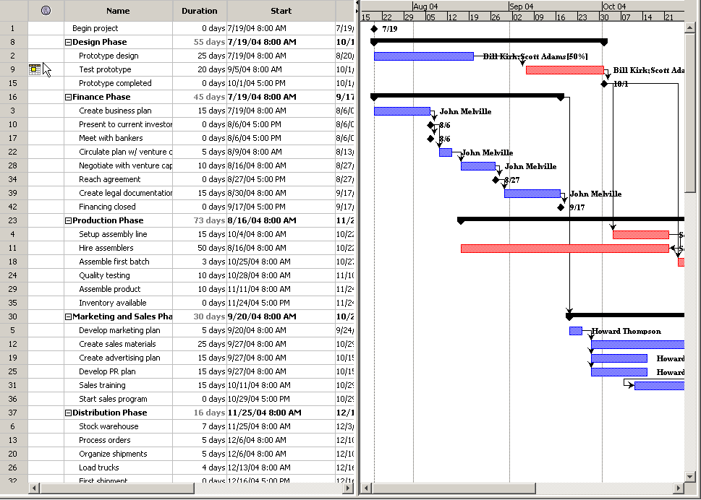
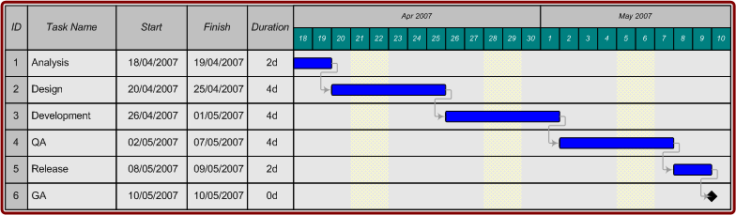
Gantt Charts

Slide 36
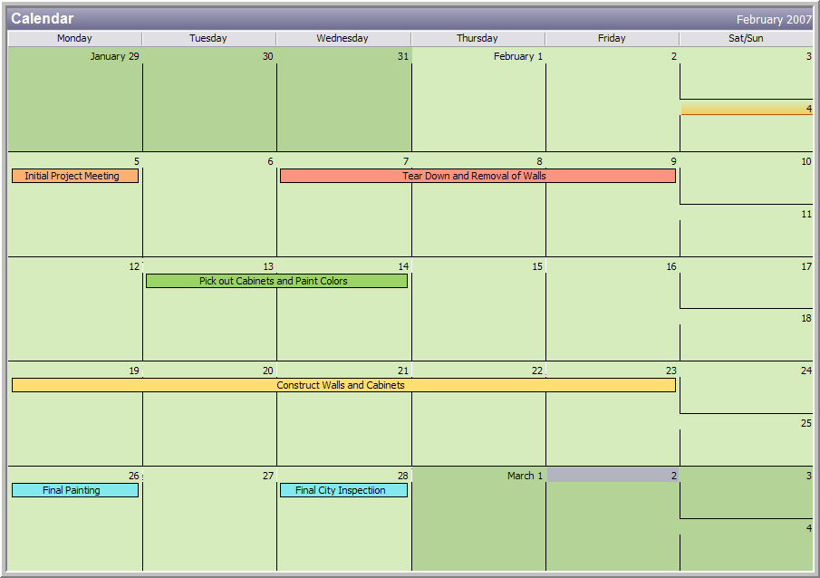
Calendars

Slide 37
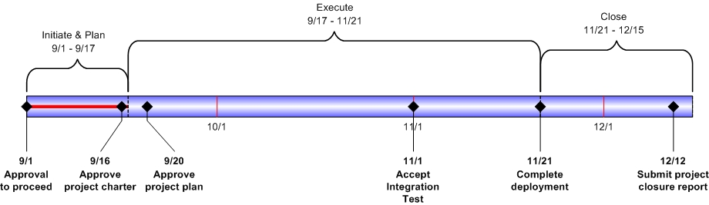
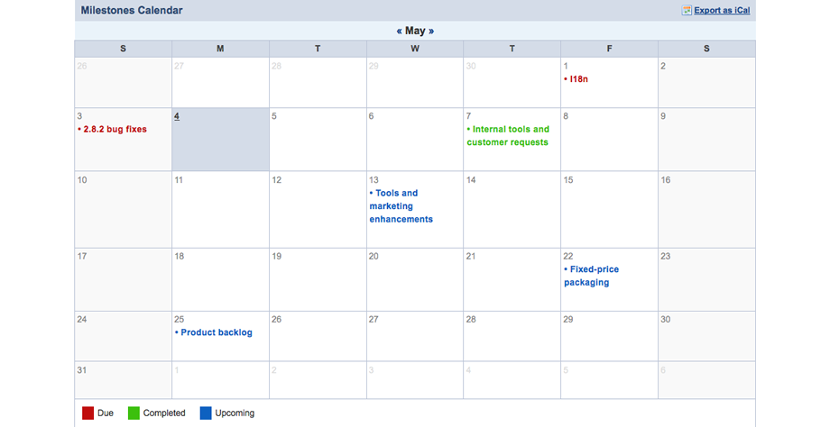
Milestones

Slide 38
Key Messages
Don’t expect to know all the project details at the beginning of the project. The further along you are, the more you know about what it will take to complete.
An estimate is a best guess
Pick the right scheduling tool for the type of project and project team

Slide 39
Resolving and Monitoring Issues
Identification and Prioritization
Resolution and Monitoring

Slide 40
Issue Management
Step | Description
1. Identification | Issues arise throughout the life-cycle of a project. It is the responsibility of project team members and stakeholders to identify issues that might negatively impact project outcomes. The project manager will include an agenda item during each project team meeting to discuss the status of known issues and to identify any new issues that might have materialized.
2. Prioritization | Once an issue has been identified, the project team will work together to assign the issue a High, Medium, or Low priority. This priority rating will then be used to determine the order in which project team and stakeholder time and effort will be applied to solve the issue. The Issue Priority will be recorded in the Issue Log.

Slide 41
Issue Management
Step | Description
3. Resolution | Each issue will also be assigned an Owner and a Target Date which will be added to the Issue Log. The owner is the individual responsible for developing and managing the plan for resolving the issue on or before the target date. If the resolution plan requires significant effort, the project manager will also revise the project schedule to reflect the required activities.
4. Monitoring | The status of each Open issue will be reviewed at each project team meeting. The issue Owner will be responsible for providing an update to the team with a summary entered in the Status column of the Issue Register. If an issue has been resolved, the Issue Status in the Issue Log will be changed to Closed. All High priority, Open issues will be reviewed regularly with the project sponsor and the Steering Committee.

Slide 42
Planning and Managing Risk
Key Risk Terminology
Risk Mitigation Planning

Slide 43
Key Risk Terminology
Risk
Possible event that could endanger the planned course or goals of the project
Example: Computer lab computers are unstable
Issue
Is a situation, problem, or an activity that has happened or is happening which impacts upon the approved Project Plan
Example: Computer lab computers are not working on day of testing
Action
Task that requires resolution
Example: Contact computer lab technician to fix computer lab computers

Slide 44
Risk Mitigation Planning
Step | Description
1. Identification | The project manager will facilitate risk identification meetings that include project team members and key stakeholders. Identified risks will be captured in the Risk Register and posted to the project site.
2. Ratings and Prioritization | Once risks are identified it is important to determine the probability and impact of each risk in order to allow the project team to prioritize the risk avoidance and mitigation strategy. Risks which are more likely to occur and have a significant impact on the project will be the highest priority risks while those which are less likely or have a low impact will be a much lower priority. As part of the Risk Identification meeting, the project team and stakeholders will also prioritize the identified risks based on impact and probability. The impact and probability assessments for each risk will be recorded in the Risk Register

Slide 45
Risk Mitigation Planning
Step | Description
3. Mitigation and Avoidance | Once risks have been prioritized, the team must determine how to address those risks which have the greatest potential probability and impact on the project. Once the initial risk assessment has been completed, the project team will work together to develop risk responses and mitigation strategies for each high priority risk. These risk avoidance and mitigation strategies will be recorded in the project Risk Register.

Slide 46
Risk Response Terms
Things to think about when planning risk mitigations
Response | Description
Avoid | The risk is avoided by changing the project in someway to bypass the risk.
Transfer | Some or all of the risk is transferred to a third party.
Reduce | Action is taken to reduce either the likelihood of the risk occurring or the impact that it will have.
Accept | The risk may be accepted perhaps because there is a low impact or likelihood.
Mitigation | Here a plan is put in place to respond if the risk is realized

Slide 47
Risk Mitigation Planning
Step | Description
4. Monitoring | The key to risk monitoring is to ensure that it is continuous throughout the life of the project and includes the identification of trigger conditions and thorough documentation of the process. Each risk will be assigned a Risk Owner who will assume responsibility for managing and monitoring the individual risk throughout the project life-cycle. High priority risks will be reviewed regularly with the project sponsor and the project steering committee.

Slide 48
Project Management Office
Definition
Value Functions

Slide 49
What is a PMO?
A project management office (PMO) is a centralized organization which:
facilitates the selection, management and delivery of projects and programs
strives to standardize and ensure consistency in the execution of projects
Will typically handle projects, programs and portfolios

Slide 50

University of Oregon PMO
Enhance the university’s ability to deliver projects on time and on budget while improving overall project delivery quality.
Staff IS projects
with PMO project managers & business analysts, reducing time non-PMO personnel manage larger projects
Enable consistent delivery
by developing and using frameworks, tools, templates and best practice processes
Maintain IS project portfolio
which consists of selecting projects that best achieve the universities operational and financial goals, while meeting customers needs and within our resource constraints
Spotlight project health
Provide training and guidance
Build communities of practice
through monitoring project progress & addressing issues quickly
for project managers & business analysts campus-wide and for resources who work on IT projects
by taking leadership role throughout the university

Slide 51

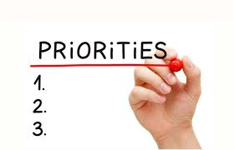

PMO Value Functions – IS Specific
Function | Planning | Prioritization | Delivery
Value | Transmits common message, reduces confusion, simplifies & improves consistency, improves communications, enables development of portfolio | Organizes and manages future requests, governs resource issues, integrates scheduling, streamlines project workflow | Reduces risk to projects, improves compliance, assists junior staff to become successful, contributes to project performance
Tasks | Facilitates communication Oversees project work consistency & completeness A central point for requests Provides broader sense of ‘what is going on’ | Confirms portfolio allocations Aligns resources to organization objectives Reduces risk of working on too many projects simultaneously | Ensures projects are progressing Validates risks and issues Facilities problem resolution Mentors and aids project team in execution

Slide 52

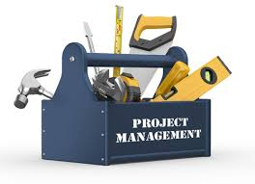
PMO Value Functions – Campus Wide
Function | Mentoring | Tools & Best Practices
Value | Improves consistency of effort, contributes to professional development and project performance, promotes continuous process improvement | Improves consistency, simplifies process workflows, contributes to project performance, promotes continuous process improvement
Tasks | Promotes Project Management practices Provides training on roles and responsibilities Assists in use of PM tools, templates and common language | Delivers best practices to PM practitioners Promotes common language to reduce misunderstanding Maintains document libraries

Slide 53
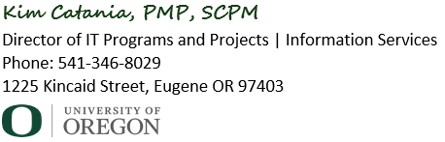
Project Management Office
itpmo@uoregon.edu
x

Slide 54
Thank You

